Slide 1

Lessons Learned From Agile Quality Assurance In Scrum

Slide 2
Agenda
Product quality
Code quality
Known issues in building cloud-based system
Cautions

Slide 3
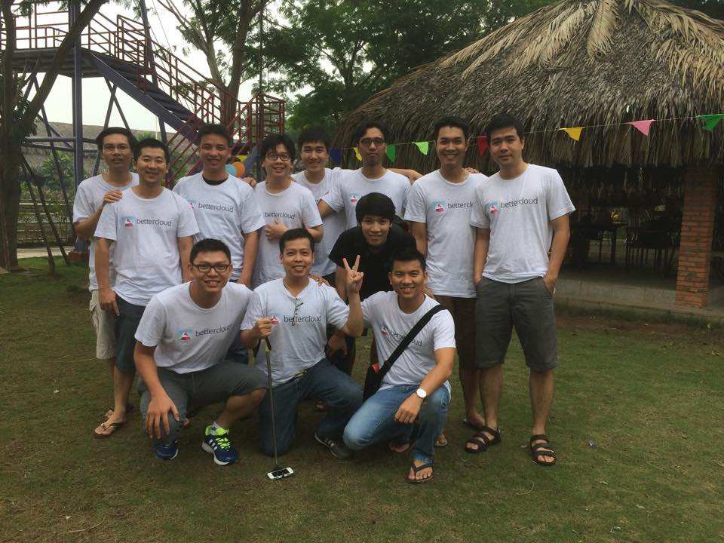
Presenter
Name: Liep Nguyen
Role: Software Engineer
Team: BetterCloud

Slide 4
Agenda
Product quality
Code quality
Known issues in building cloud-based system
Cautions

Slide 5
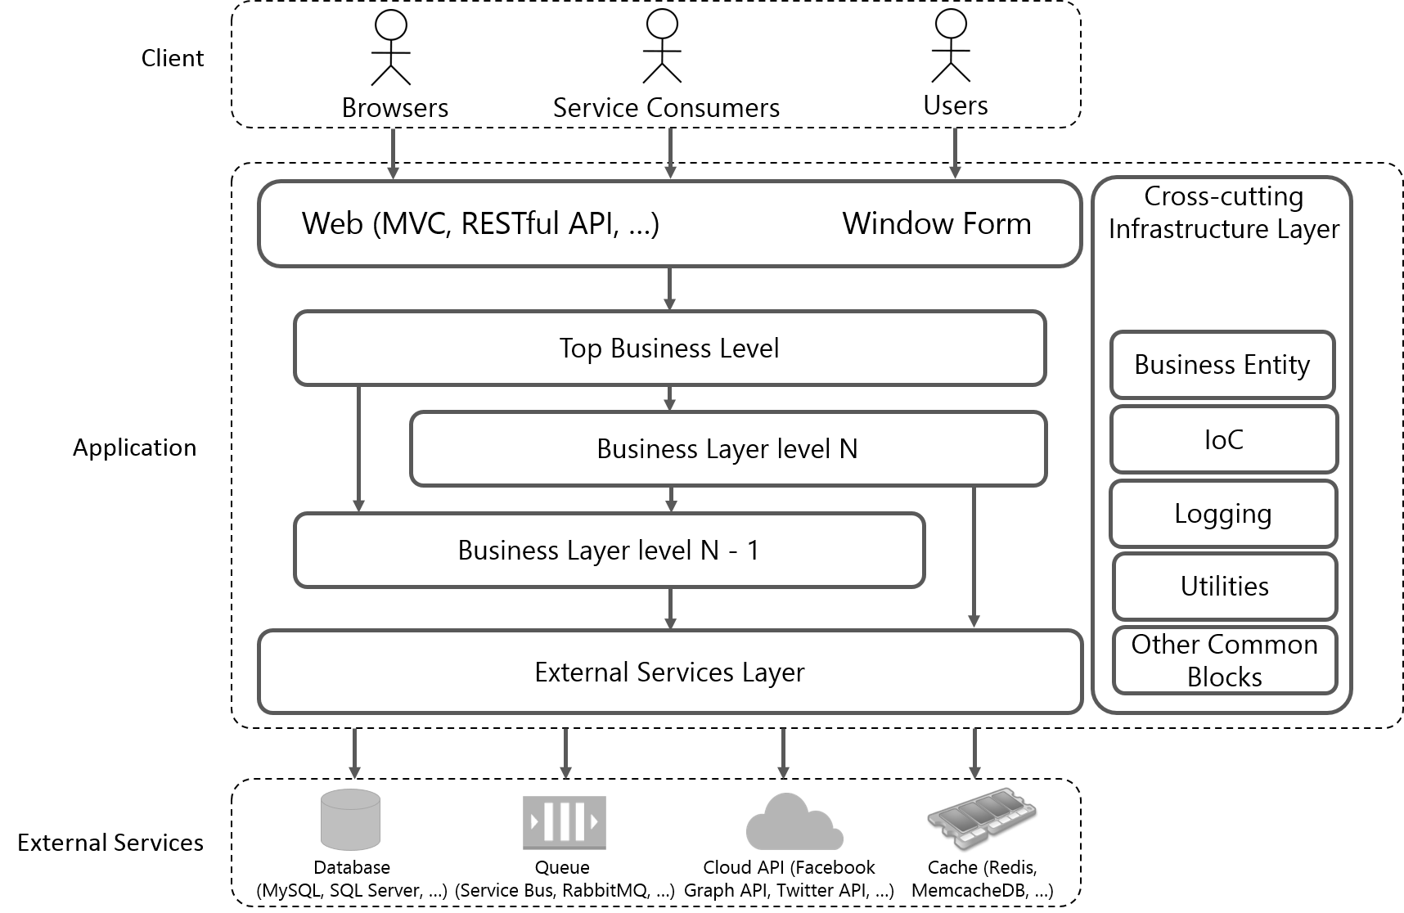
The conceptual structure of an application

Slide 6
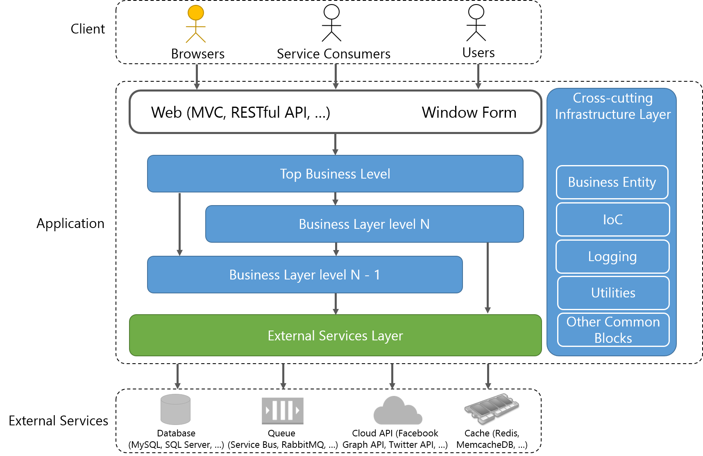
Software components and their testing
Covered by “GUI Unit” Testing
Covered by Unit Testing
Covered by Integration Testing

Slide 7

Entire Application Testing
System Testing
Automated System Testing
Manual System Testing
End-To-End Testing
“Behind-The-Scenes” Testing

Slide 8
Demo Types of Testing
GUI Unit Testing
Unit Testing
Integration Testing

Slide 9
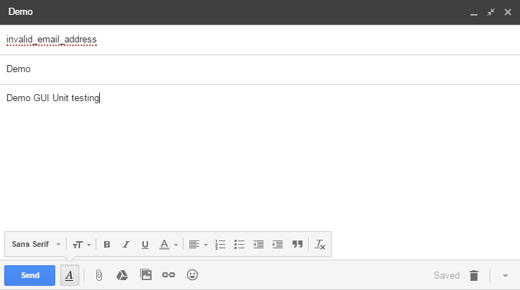
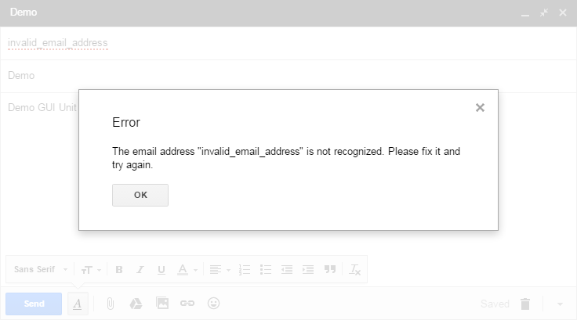
Demo GUI Unit Testing
1
public void VerifyErrorMessageDisplayWhenUserComposeNew... ()
{
// arrange
GmailPage gmailPage = new GmailPage();
string emailAddress = "invalid_email_address";
...
// act
MessageModal newMessageModal = gmailPage.ComposeNewMessage();
...
newMessageModal.Send();
// assert
string errorMessage = newMessageModal.GetErrorMessage();
Assert.AreEqual(expectedErrorMessage, errorMessage);
}
2

Slide 10
Demo Integration Testing

Slide 11
Demo Unit Testing
public void RetrieveUsersHavingAdminRole_ReturnsExact1UserHavingAdminRole_WhenThereAre...()
{
// arrange
...
UserService userService = new UserService(userRepositoryMock.Object, roleServiceMock.Object);
...
userRepositoryMock.Setup(x => x.RetrieveAllUsers())
.Returns(new[] { expectedUserMock.Object, unexpectedUserMock.Object });
roleServiceMock.Setup(x => x.RetrieveRolesByUserId(expectedUserMock.Object.UserId))
.Returns(new[] { adminRoleMock.Object, designerRoleMock.Object });
// act
var result = userService.RetrieveUsersHavingAdminRole();
// assert
Assert.AreEqual(1, result.Count());
var actual = result.First();
Assert.AreEqual(actual.UserId, expectedUserMock.Object.UserId);
}

Slide 12
Agenda
Product quality
Code quality
Known issues in building cloud-based system
Cautions

Slide 13
Code Review
Dev
“dev” branch
Feedback
Submit new code
Peer Dev
Code Analysis Tool
Merge

Slide 14
Reviewing Criteria
Assert coding conventions
Assert algorithms
Assert OOP design
Assert project conventions (file location, project name, configuration, etc.)

Slide 15
Benefits
Detect hidden faults / bugs very soon
Code is refactored frequently
Ensure code quality
Reduce risk of re-do things

Slide 16
Agenda
Product quality
Code quality
Known issues in building cloud-based system
Cautions

Slide 17
Known issues in building cloud-based system
Limited network access because of company firewall
Randomly timeout error happened because of physical distance
Un-optimize license purchase
Multiple time-zone
Shared resources (Queue, Cloud Account)

Slide 18
Agenda
Product quality
Code quality
Known issues in building cloud-based system
Cautions

Slide 19
Cautions
Code review
Take time, blocking  bottleneck in reviewing
Tests
1:3 ratio
Require QA-mindset from Dev
Maintenance

Slide 20
References

Slide 21
Thank you for listening

Slide 22
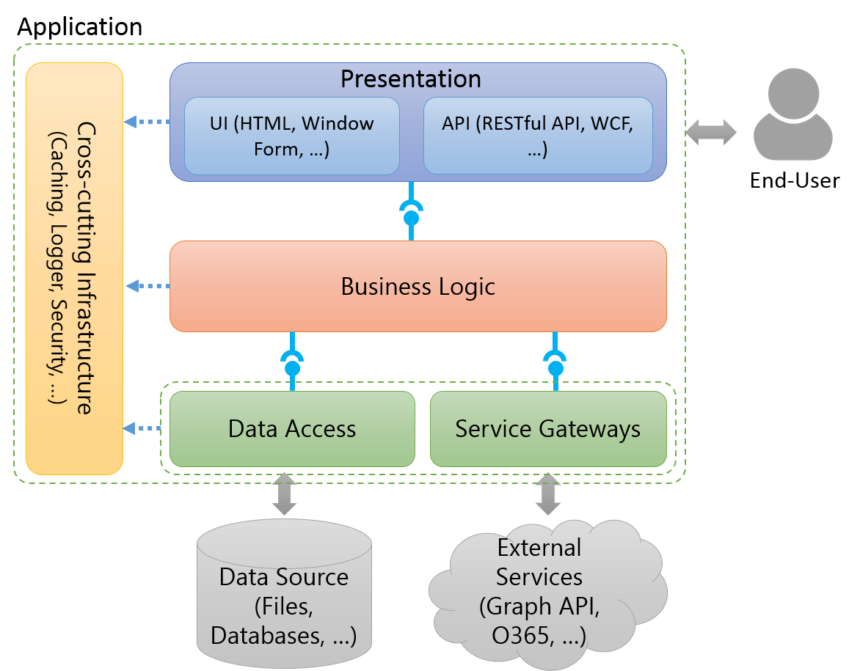
The conceptual structure of an application to software testing
Notes:
To talk something about the conceptual structure of an application to show to audiences the structure which is applied in almost applications.

Slide 23
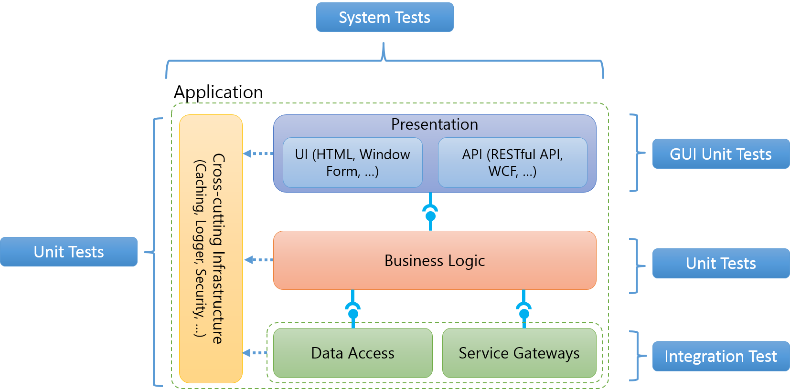
The conceptual structure of an application to software testing
Notes:
To indicate what aspects of an application are covered which types of test (Ex: Business Logic is covered by unit tests.)

Slide 24

Application
Cross-cutting Infrastructure
(Caching, Logger, Security, …)
Presentation
UI (HTML, Window Form, …)
API (RESTful API, WCF, …)
End-User
Business Logic
Data Access
Service Gateways
Data Source (Files, Databases, …)
External Services (Graph API, O365, …)

Slide 25
System Tests
Application
Cross-cutting Infrastructure
(Caching, Logger, Security, …)
Presentation
UI (HTML, Window Form, …)
API (RESTful API, WCF, …)
GUI Unit Tests
Unit Tests
Business Logic
Unit Tests
Data Access
Service Gateways
Integration Test
Notes:
http://blogs.msdn.com/b/jmeier/archive/2008/11/24/application-architecture-diagrams-added-to-codeplex.aspx

Slide 26




Client
Browser
Web Server
Business Entity
Presentation
Cross-cutting Infrastructure
UI (MVC, Window Form, …)
API (RESTful API, WCF, …)
Configuration
Business Logic
Logging
Utilities
Service Gateways
Other Common Blocks
Database
(Cassandra, MongoDb, …)
Queue
(Service Bus, RabbitMQ, …)
Cloud API (Facebook Graph API, Twitter API, …)
Memcache (Redis, MemcacheDB, …)
Notes:
http://blogs.msdn.com/b/jmeier/archive/2008/11/24/application-architecture-diagrams-added-to-codeplex.aspx

Slide 27


Client
Browsers
Service Consumers
Users
Web (MVC, RESTful API, …)
Window Form
Cross-cutting Infrastructure Layers
Top Business Level
Business Entity
Application
Business Layer level N
IoC
Logging
Business Layer level N - 1
Utilities
External Services Layer
Other Common Blocks
External Services
Database
(MySQL, SQL Server, …)
Queue
(Service Bus, RabbitMQ, …)
Cloud API (Facebook Graph API, Twitter API, …)
Cache (Redis, MemcacheDB, …)

Slide 28
Client
Browsers
Service Consumers
Users
Web (MVC, RESTful API, …)
Window Form
Cross-cutting Infrastructure Layers
Top Business Level
Business Entity
Application
Business Layer level N
IoC
Logging
Business Layer level N - 1
Utilities
External Services Layer
Other Common Blocks
External Services
Database
(MySQL, SQL Server, …)
Queue
(Service Bus, RabbitMQ, …)
Cloud API (Facebook Graph API, Twitter API, …)
Cache (Redis, MemcacheDB, …)

Slide 29
Covered by Unit Testing
Covered by GUI Unit Testing
Covered by Integration Testing

Slide 30

Client
Browsers
Service Consumers
Users
Web (MVC, RESTful API, …) Window Form
Cross-cutting Infrastructure Layer
Top Business Level
Business Entity
Application
Business Layer level N
IoC
Logging
Business Layer level N - 1
Utilities
External Services Layer
Other Common Blocks
External Services
Database
(MySQL, SQL Server, …)
Queue
(Service Bus, RabbitMQ, …)
Cloud API (Facebook Graph API, Twitter API, …)
Cache (Redis, MemcacheDB, …)

Slide 31

Client
Browsers
Service Consumers
Users
Web (MVC, RESTful API, …) Window Form
Cross-cutting Infrastructure Layer
Top Business Level
Business Entity
Application
Business Layer level N
IoC
Logging
Business Layer level N - 1
Utilities
External Services Layer
Other Common Blocks
External Services
Database
(MySQL, SQL Server, …)
Queue
(Service Bus, RabbitMQ, …)
Cloud API (Facebook Graph API, Twitter API, …)
Cache (Redis, MemcacheDB, …)

Slide 32
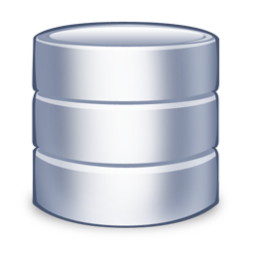
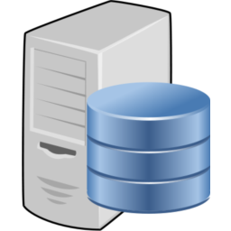

Source Repository
Build Server
Development Machine

